Slide 1
Convolutional Neural Networks and Transfer Learning for Bird Images Classification
Tzanis Nikolaos – mtn2217

Slide 2
Introduction
In the vast world of birds, our ability to identify the species of a bird based solely on its external characteristics has always been a major challenge.
However, the progress of technology, particularly advancements in computer vision and deep learning, has brought us one step closer to achieving this goal. In fact, a significant breakthrough, especially in image classification, has been made with the application of Convolutional Neural Networks (CNN). By training these networks on datasets containing a large number of bird images, we can teach them to recognize specific features of birds that differentiate one species from another.

Slide 3
Table of contents
Training and Optimizing a Convolutional Neural Network
01
Transfer Learning
02
85.000 Bird Images
525 Different Species
30.000 Bird Images
25 Different Species

Slide 4



Libraries

Slide 5
1
Training and Optimizing a Convolutional Neural Network

Slide 6
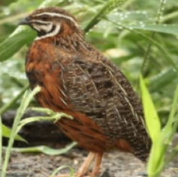
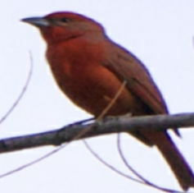
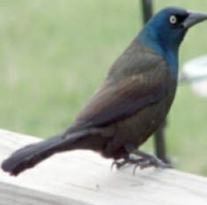
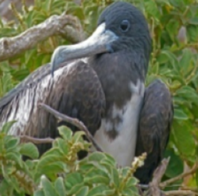
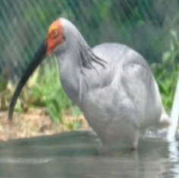
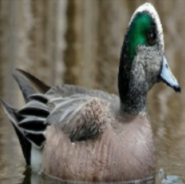
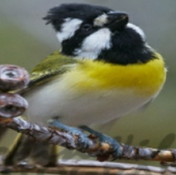
84,635
Images on the Training Dataset

Slide 7
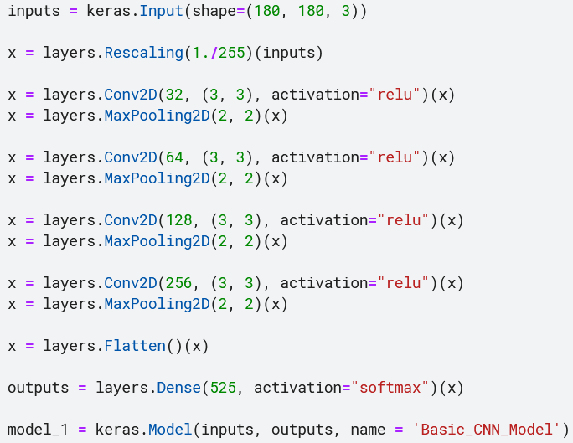
A Basic CNN Model

Slide 8
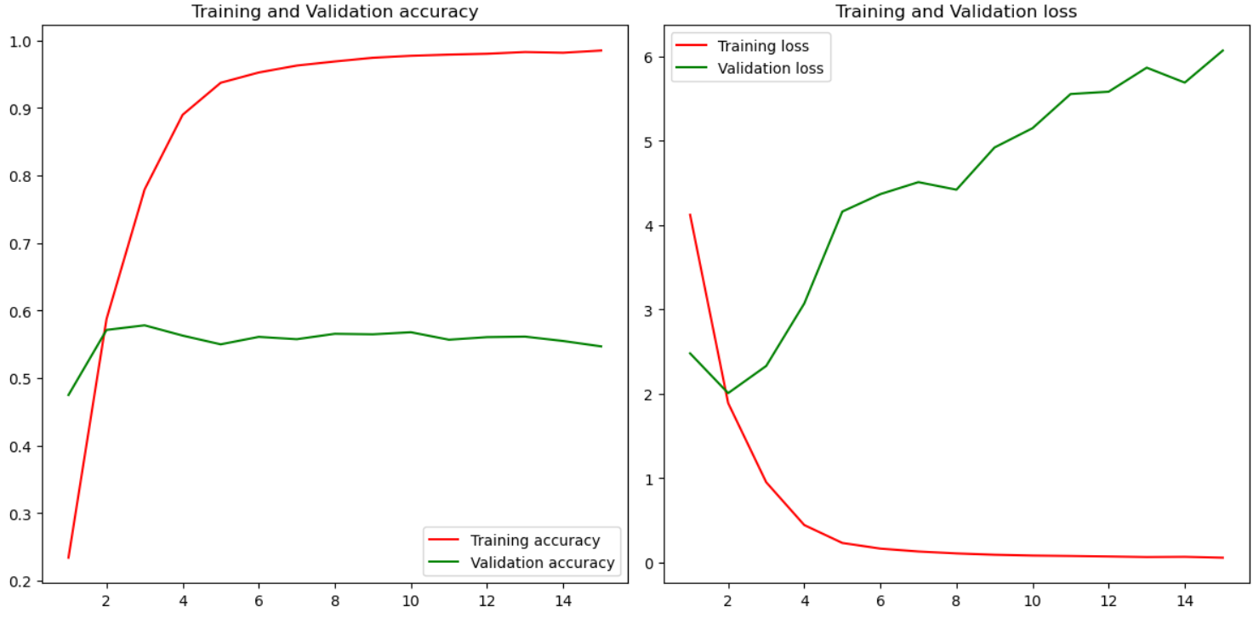


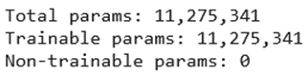
A Basic CNN Model
Training: 98%
Validation: 57%

Slide 9
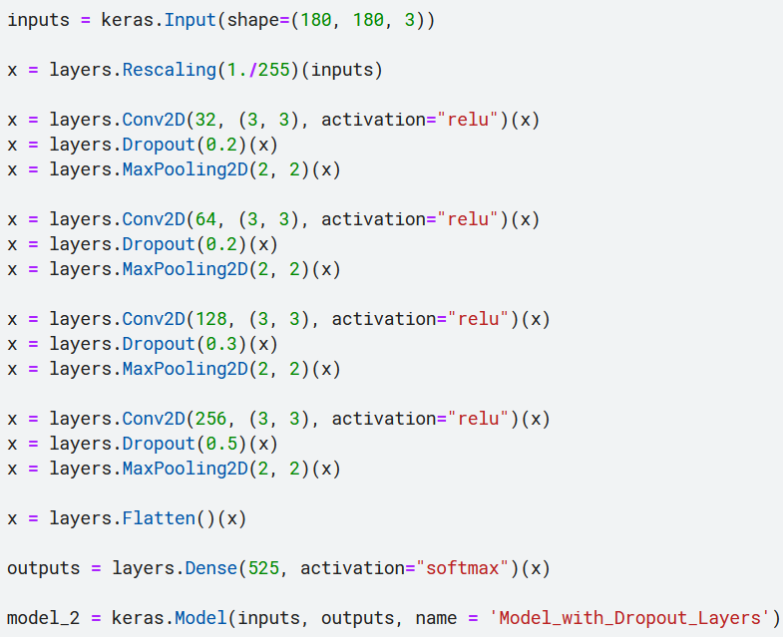
Adding Dropout Layers

Slide 10
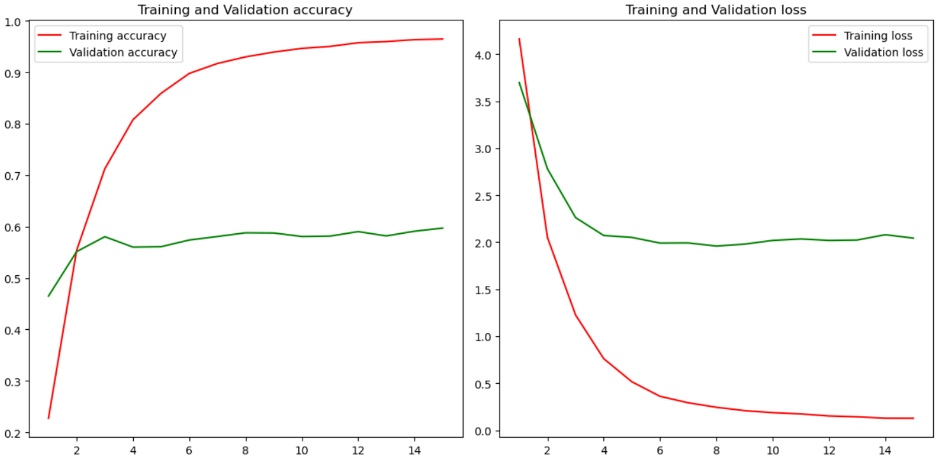
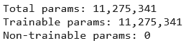
Adding Dropout Layers
Training: 96%
Validation: 60%

Slide 11
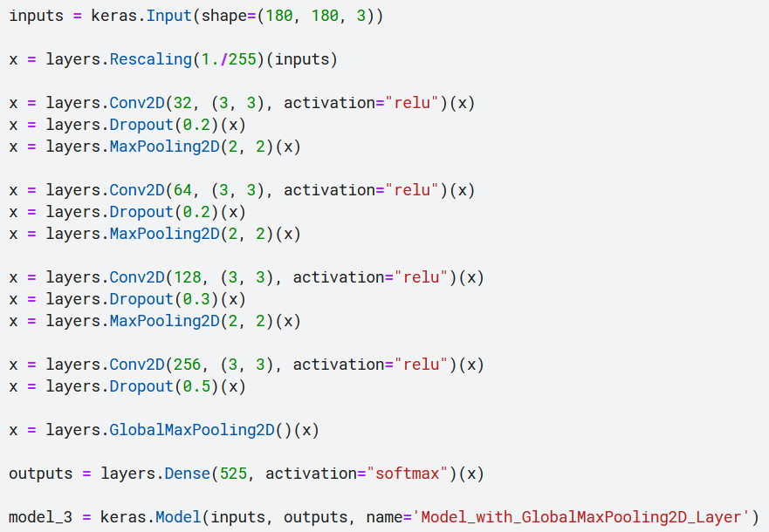
Replacing the Flatten Layer with GlobalMaxPooling2D

Slide 12
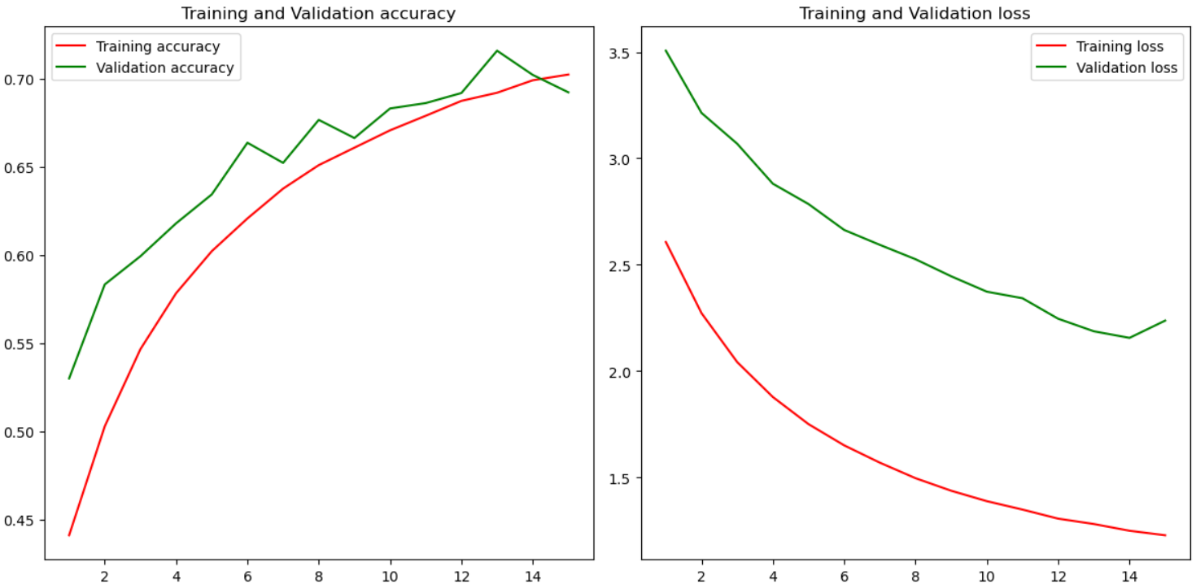
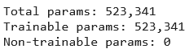
Replacing the Flatten Layer with GlobalMaxPooling2D
Training: 70%
Validation: 71%

Slide 13
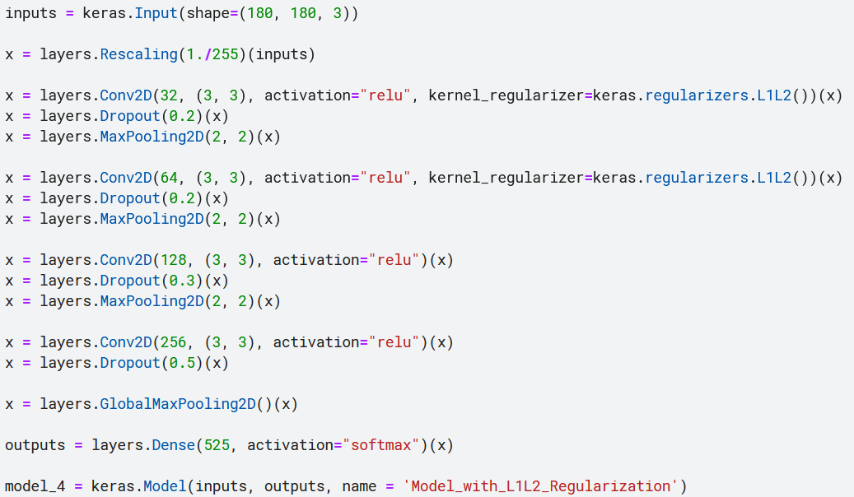
Adding L1/L2 Regularization

Slide 14
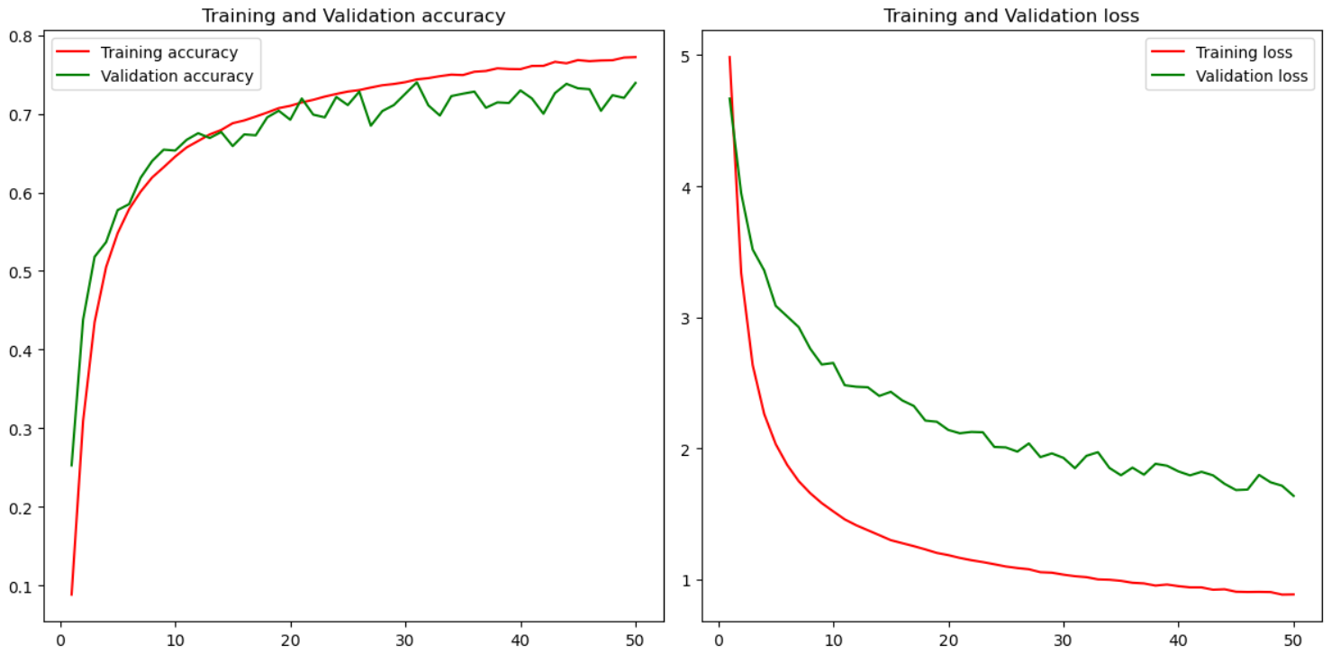
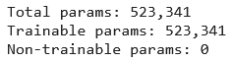
Adding L1/L2 Regularization
Training: 77%
Validation: 74%

Slide 15
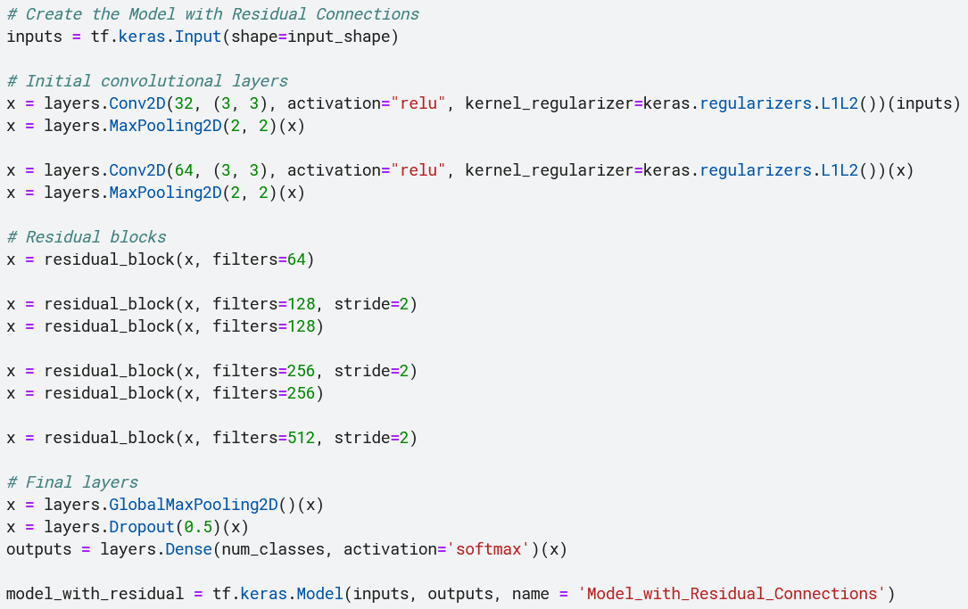
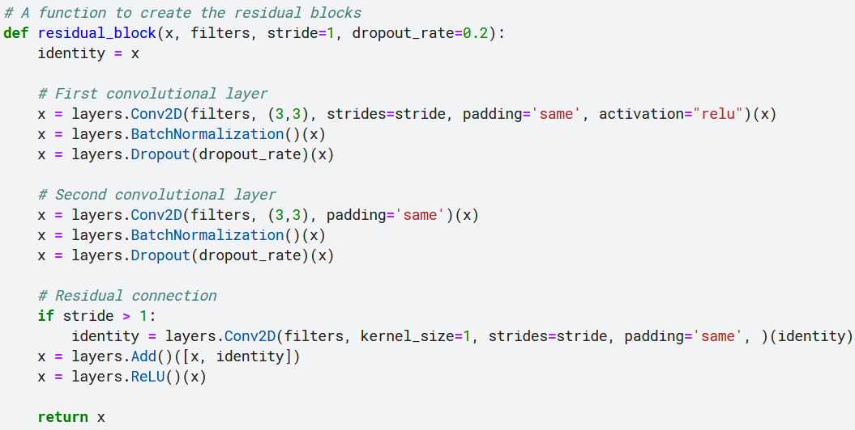
Adding Residual Connections

Slide 16
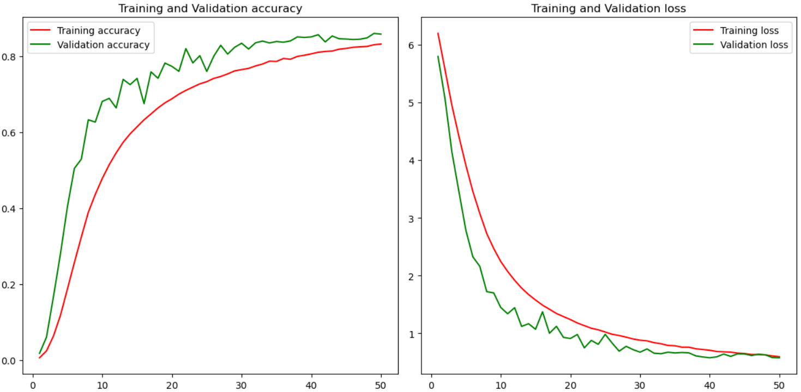
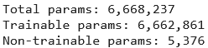
Adding Residual Connections
Training: 83%
Validation: 86%

Slide 17
Conclusions
Model | Seconds/Epoch | Training Accuracy | Validation Accuracy
Basic CNN | 136 | 98% | 58%
+Dropout | 123 | 96% | 59%
-Flatten +GlobalMaxPool | 125 | 70% | 71%
+L1/L2 Reg | 123 | 77% | 74%
+Residual | 136 | 83% | 86%

Slide 18
2
Transfer Learning

Slide 19
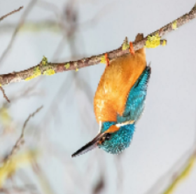
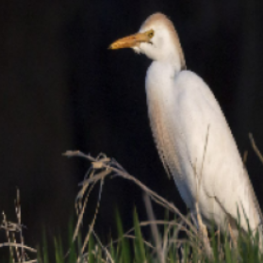
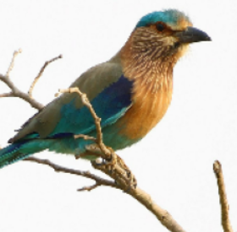
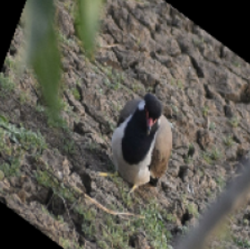
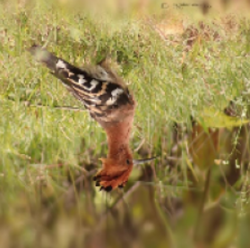
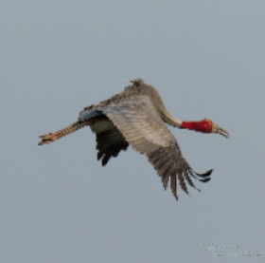
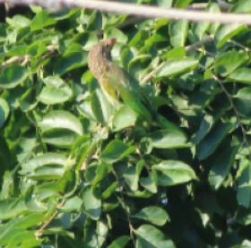
30,000
Images on the Training Dataset

Slide 20
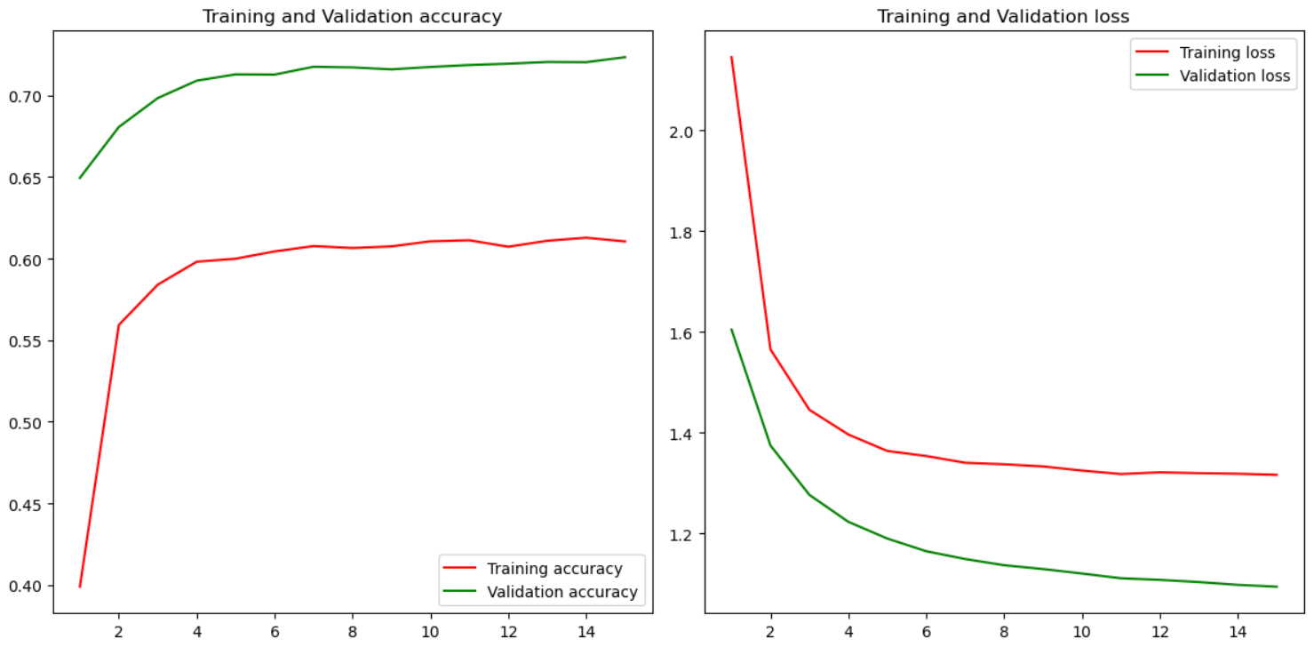
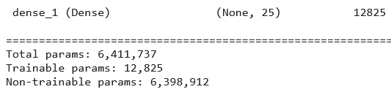
Transfer Learning with the Best Model
Training: 61%
Validation: 72%

Slide 21
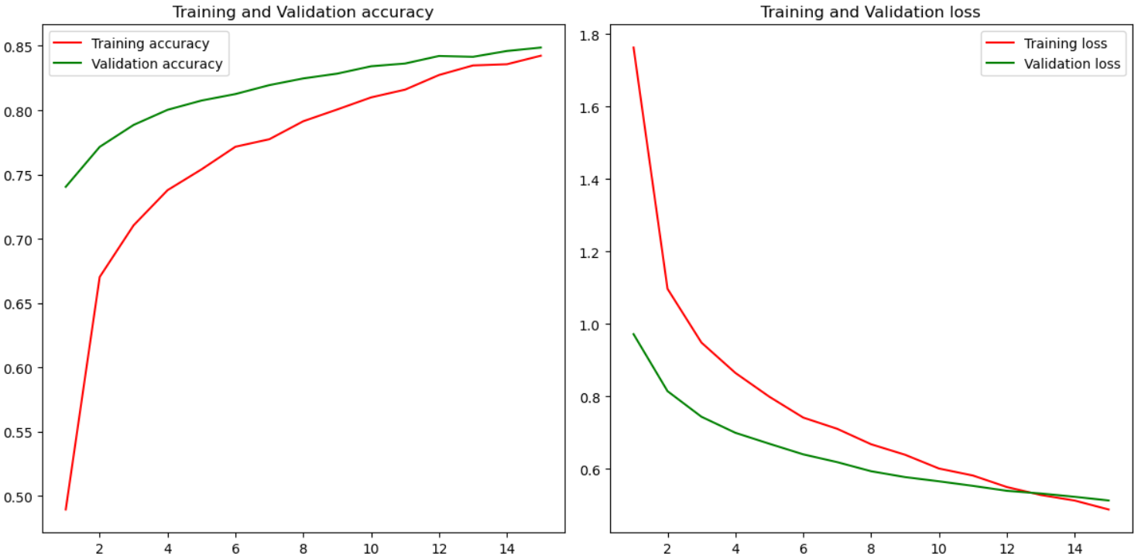
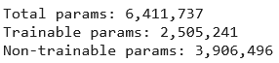
Transfer Learning with More Trainable Layers
Training: 84%
Validation: 84%

Slide 22
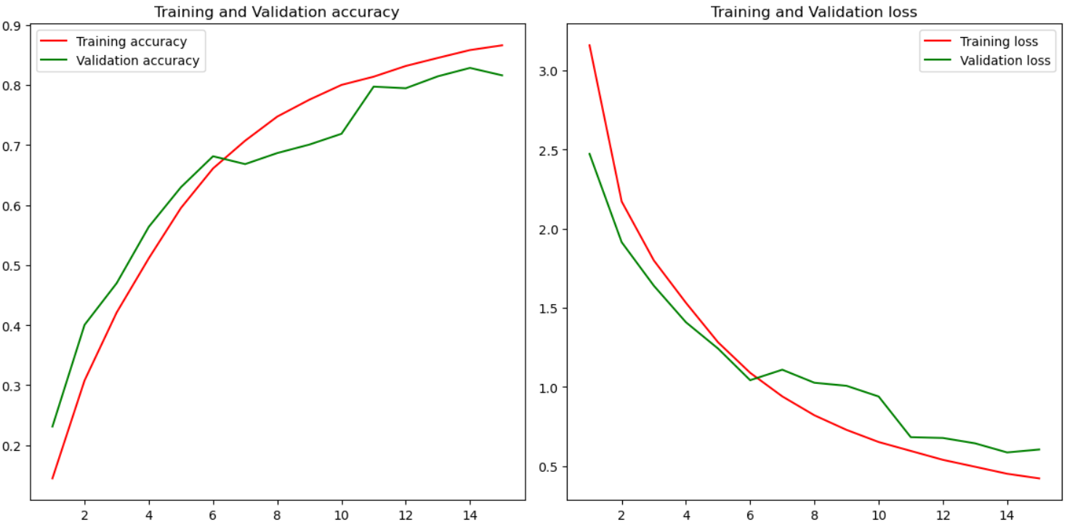
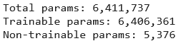
What About Training the Same Model Architecture from Scratch?
Training: 86%
Better but…
… slower!
Validation: 82%

Slide 23
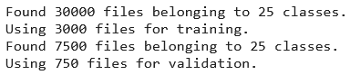
What About Smaller Datasets?

Slide 24
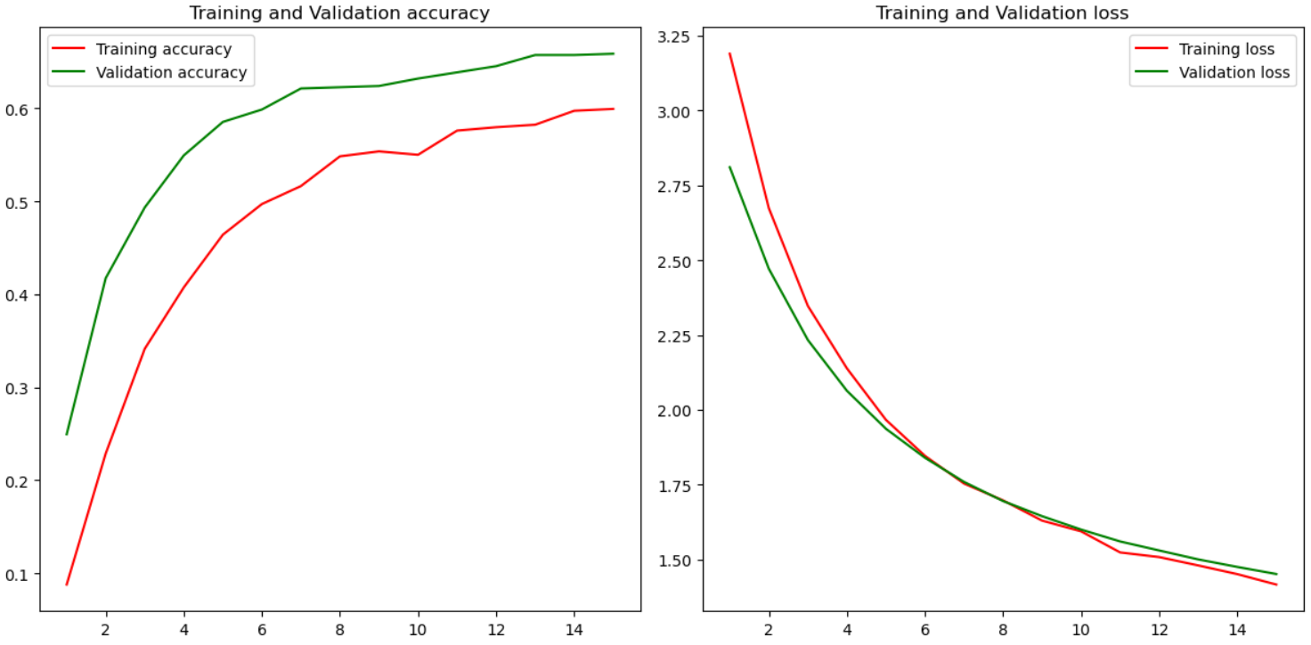
Transfer Learning with the Best Model on 10% of the Dataset
Training: 60%
Validation: 65%

Slide 25
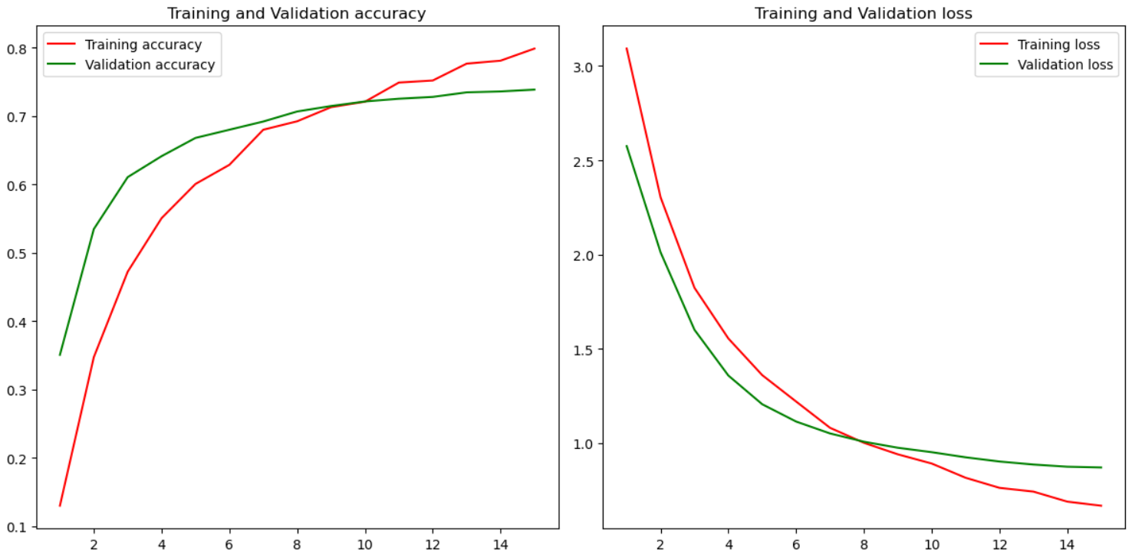
Transfer Learning with the Best Model and More Trainable Layers
Training: 80%
Validation: 74%

Slide 26
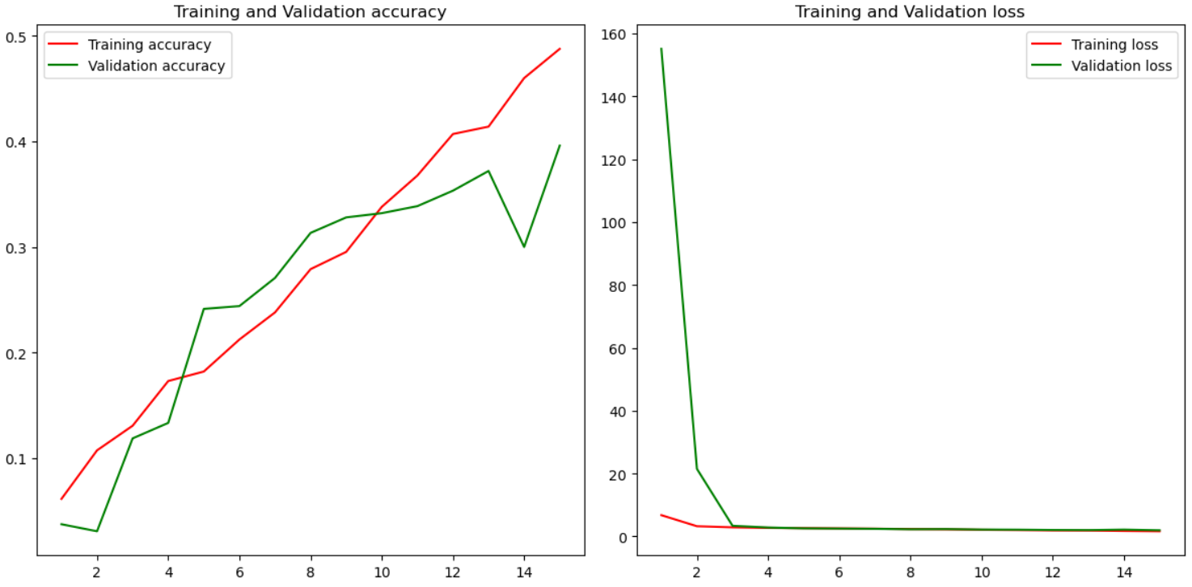
What About The Model from Scratch on the Small Dataset?
Training: 48%
Alot worse!
Validation: 39%

Slide 27
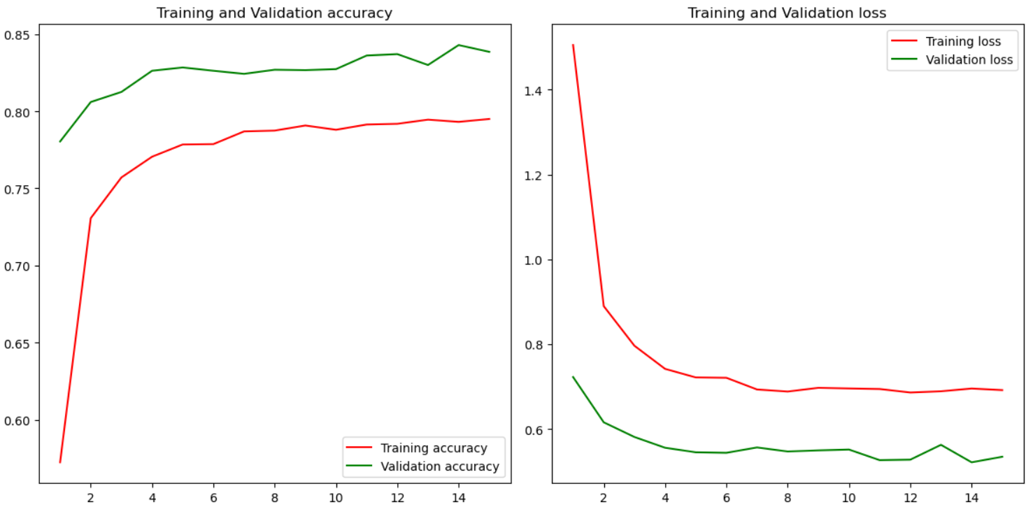
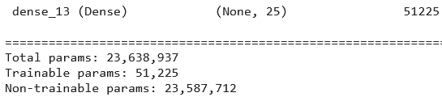
Bonus: ResNet Model
Training: 80%
Best one yet!
Validation: 85%

Slide 28
Conclusions
Model | Seconds/Epoch | Training Accuracy | Validation Accuracy
Transfer | 180 | 61% | 72%
+Layers Trainable | 173 | 84% | 85%
From Scratch | 198 | 86% | 82%
Transfer Small Dataset | 18 | 60% | 65%
+Layers Trainable Small Dataset | 19 | 80% | 73%
From Scratch Small Dataset | 25 | 48% | 40%
ResNet | 187 | 80% | 85%

Slide 29
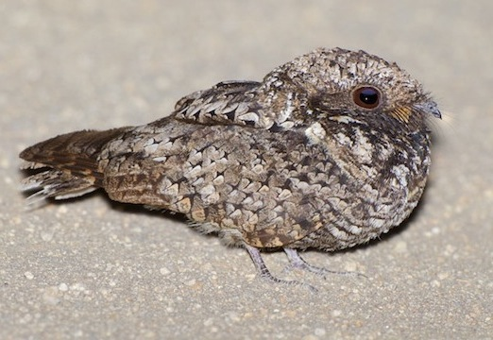
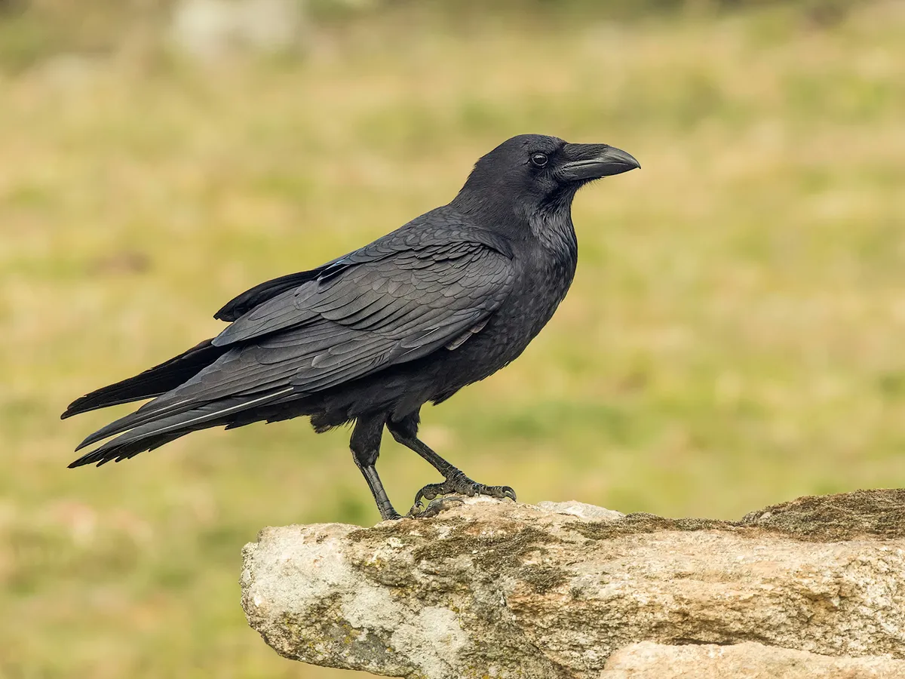
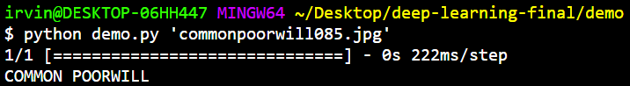
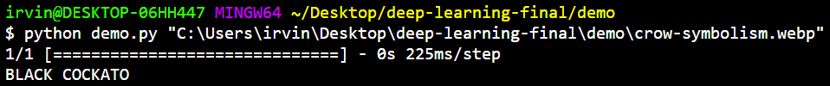

Demo (Using the Model with Residual Connections)
Common Poorwill
Crow

Slide 30
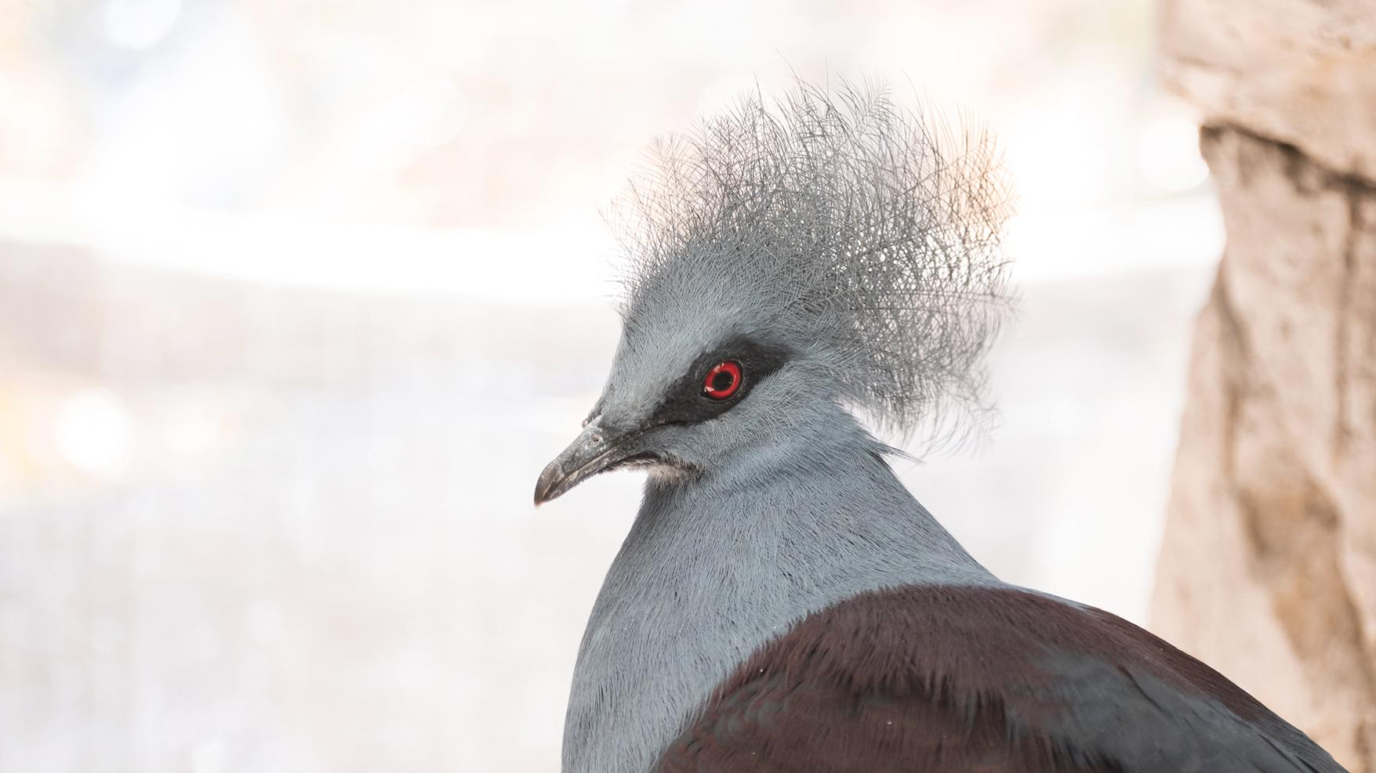
Thank you for your time!

